Slide 1

My Compiler Did What?!?
https://github.com/MikeMKH/talk-my-compiler-did-what
Mike Harris

Slide 2
Agenda
Hello World
Record Type
Enumerable
Async / Await
MoveNext()

Slide 3
Agenda
Hello World
Record Type
Enumerable
Async / Await
MoveNext()

Slide 4
Hello World
top level statement
using System;
var group = "Wisconsin .Net";
Console.WriteLine($"Hello {group} User Group!");
Action<string> sorry =
x => Console.WriteLine(
$"Sorry, {x} this is a bit ridiculous.");
sorry("everyone");
Closing("fun");
static void Closing(string state)
=> Console.WriteLine($"Hope you find it {state}!");
C#

Slide 5
using System;
internal class Program
{
private static void Main (string[] args)
{
string text = “Wisconsin .Net”;
Console.WriteLine ("Hello " + text + " User Group!");
((Action<string>)delegate (string x) {
Console.WriteLine ("Sorry, " + x + " this is a bit ridiculous.");
}) (“everyone");
Closing ("fun");
static void Closing (string state)
{
Console.WriteLine ("Hope you find it " + state + "!");
}
}
}
decompiled code
decompiler
dotnet build
dotnet run
source code
compiler
exe / dll
JIT
machine code
using System;
var group = "Wisconsin .Net";
Console.WriteLine($"Hello {group} User Group!");
Action<string> sorry =
x => Console.WriteLine(
$"Sorry, {x} this is a bit ridiculous.");
sorry("everyone");
Closing("fun");
static void Closing(string state)
=> Console.WriteLine($"Hope you find it {state}!");
Hello Wisconsin .Net User Group!
Sorry, everyone this is a bit ridiculous.
Hope you find it fun!

Slide 6
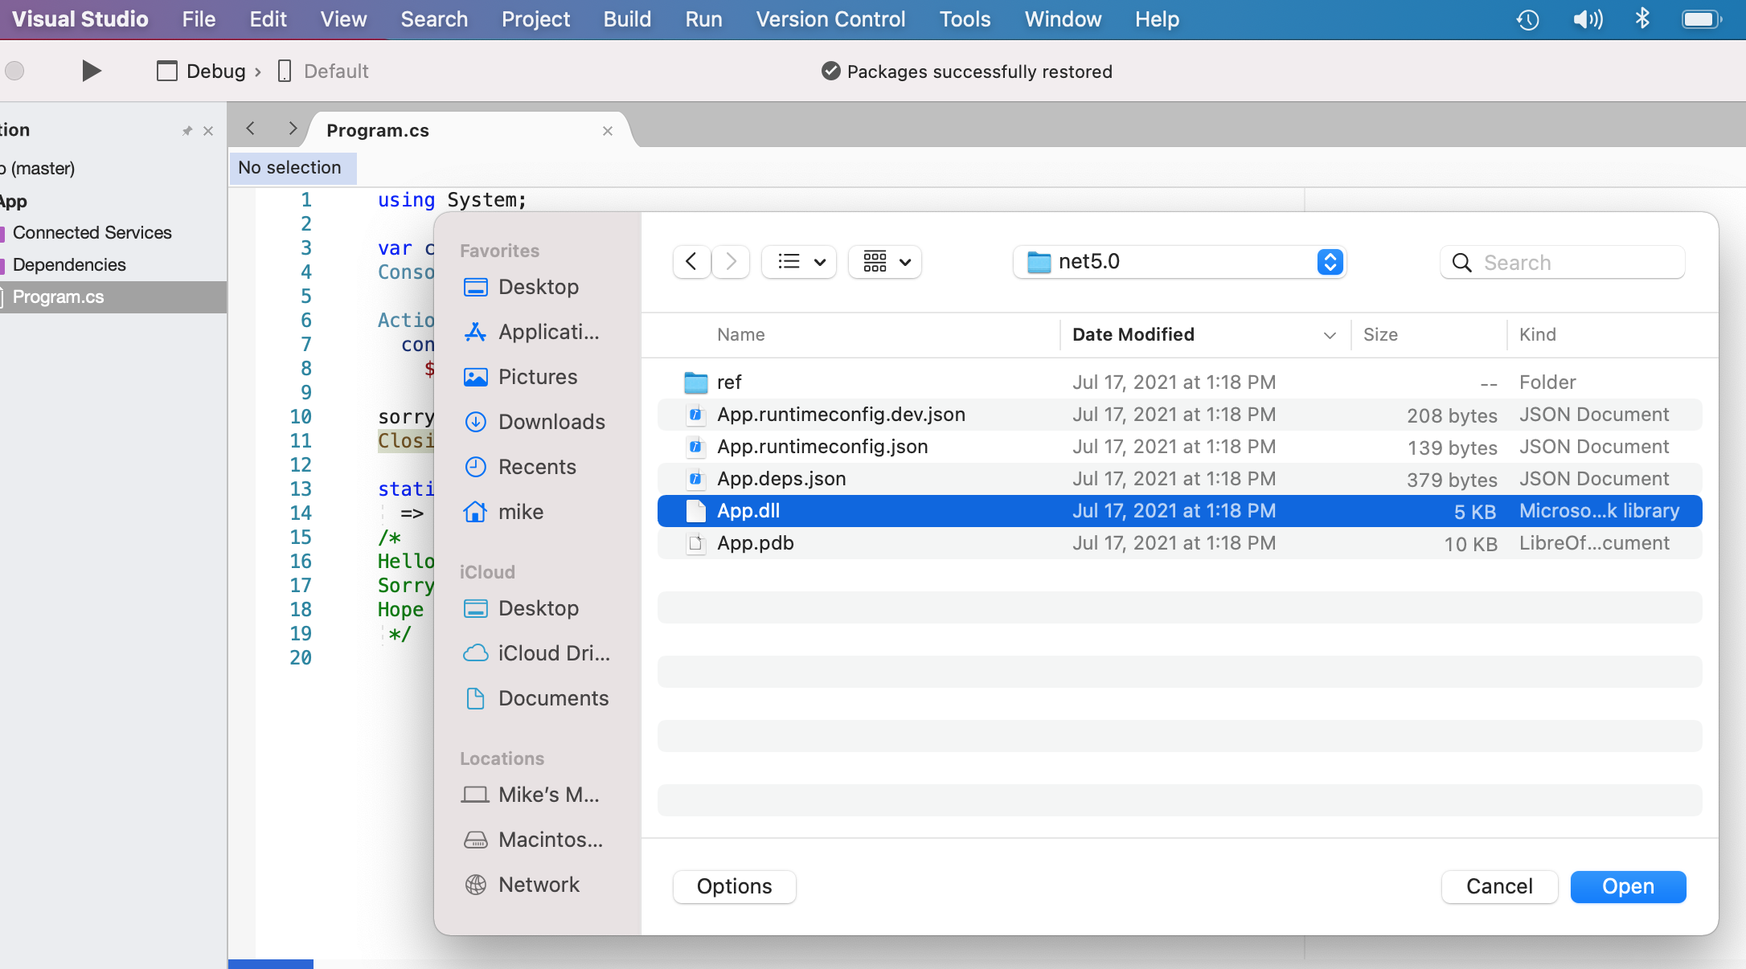

Slide 7
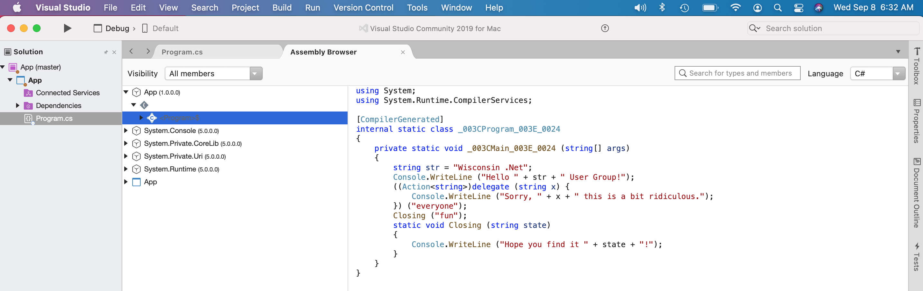

Slide 8
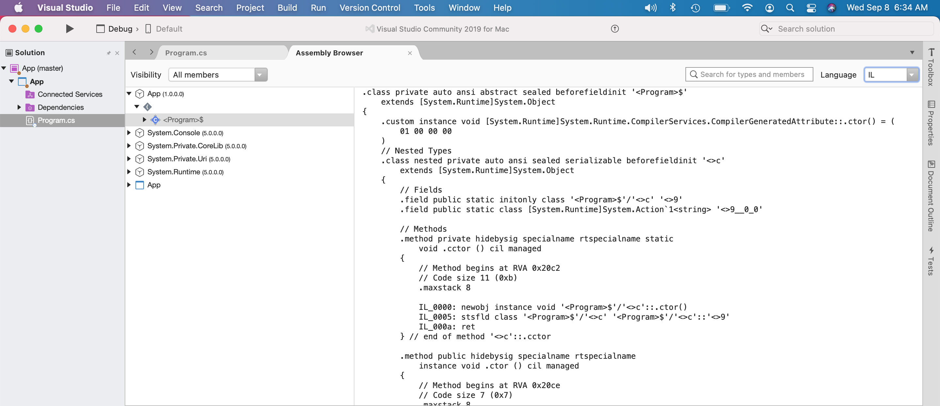

Slide 9
Hello World
Original
Compiled
using System;
var group = "Wisconsin .Net";
Console.WriteLine($"Hello {group} User Group!");
Action<string> sorry =
x => Console.WriteLine(
$"Sorry, {x} this is a bit ridiculous.");
sorry("everyone");
Closing("fun");
static void Closing(string state)
=> Console.WriteLine($"Hope you find it {state}!");
using System;
internal class Program
{
private static void Main (string[] args)
{
string text = "Wisconsin .Net";
Console.WriteLine ("Hello " + text + " User Group!");
((Action<string>)delegate (string x) {
Console.WriteLine ("Sorry, " + x + " this is a bit ridiculous.");
}) ("everyone");
Closing ("fun");
static void Closing (string state)
{
Console.WriteLine ("Hope you find it " + state + "!");
}
}
}
source code
simplified
C#
decompiled code

Slide 10
Hello World
Original
using System;
Compiled
using System;
internal class Program
{
private static void Main (string[] args)
{
}
}
top level statement
simplified
C#

Slide 11
Hello World
Original
var group = "Wisconsin .Net";
Action<string> sorry =
x => Console.WriteLine(
$"Sorry, {x} this is a bit ridiculous.”);
sorry(conference);
Compiled
string text = "Wisconsin .Net";
((Action<string>)delegate (string x) {
Console.WriteLine ("Sorry, " + x + " this is a bit ridiculous.");
}) (text);
simplified
C#

Slide 12
Hello World
Compiled
.method private hidebysig static
void '<Main>$' (
string[] args
) cil managed
{
.maxstack 3
.entrypoint
.locals init (
[0] string
)
IL_0000: ldstr "Wisconsin .Net"
IL_0005: stloc.00
Original
var group = "Wisconsin .Net";
locals
load string
IL

Slide 13
Hello World
Original
Console.WriteLine($"Hello {group} User Group!");
Compiled
Console.WriteLine ("Hello " + text + " User Group!");
simplified
C#

Slide 14
Hello World
Original
Closing("fun");
static void Closing(string state)
=> Console.WriteLine($"Hope you find it {state}!");
Compiled
Closing ("fun");
static void Closing (string state)
{
Console.WriteLine ("Hope you find it " + state + "!");
}
simplified
C#

Slide 15
Agenda
Hello World
Record Type
Enumerable
Async / Await
MoveNext()

Slide 16
Record Type
using System;
namespace App
{
public record PersonRecord(string FirstName, string LastName);
public class PersonClass
{
public PersonClass(string first, string last)
=> (FirstName, LastName) = (first, last);
public string FirstName { get; init; }
public string LastName { get; init; }
}
Record Type
Class
C#

Slide 17
Record Type
Console.WriteLine("Class record.”);
var mikeRecord = new PersonRecord("Mike", "Harris");
var otherMikeRecord = new PersonRecord("Mike", "Harris");
Console.WriteLine($"\tmikeRecord={mikeRecord}");
Console.WriteLine($"\tHello {mikeRecord.FirstName}!");
if (mikeRecord == otherMikeRecord)
{
Console.WriteLine($"\tSame old {otherMikeRecord.FirstName}.");
}
else
{
Console.WriteLine($"\tYou have changed {mikeRecord.FirstName}.");
}
C#

Slide 18
Class
Console.WriteLine("Class example.”);
var mikeClass = new PersonClass("Mike", "Harris");
var otherMikeClass = new PersonClass("Mike", "Harris");
Console.WriteLine($"\tmikeClass={mikeClass}");
Console.WriteLine($"\tHello {mikeClass.FirstName}!");
if (mikeClass == otherMikeClass)
{
Console.WriteLine($"\tSame old {otherMikeClass.FirstName}.");
}
else
{
Console.WriteLine($"\tYou have changed {mikeClass.FirstName}.");
}
C#

Slide 19
Record Type / Class
output
Class record.
mikeRecord=PersonRecord { FirstName = Mike, LastName = Harris }
Hello Mike!
Same old Mike.
Class example.
mikeClass=App.PersonClass
Hello Mike!
You have changed Mike.
C#

Slide 20
Class
Original
Compiled
public class PersonClass
{
public PersonClass(string first, string last)
=> (FirstName, LastName) = (first, last);
public string FirstName { get; init; }
public string LastName { get; init; }
}
public class PersonClass
{
public string FirstName {
get;
set;
}
public string LastName {
get;
set;
}
public PersonClass (string first, string last)
{
string text2 = FirstName = first;
text2 = (LastName = last);
}
}
C#

Slide 21
Record Type
Original
public record PersonRecord(string FirstName, string LastName);
C#

Slide 22
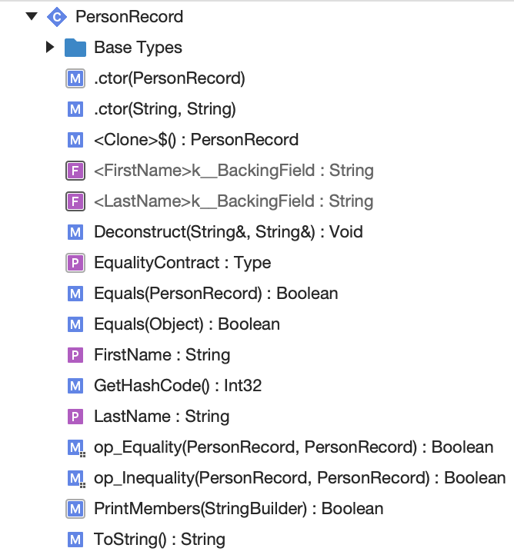
Record Type
Compiled
C#

Slide 23
Record Type
Compiled
public class PersonRecord : IEquatable<PersonRecord>
{
protected virtual Type EqualityContract {
[System.Runtime.CompilerServices.NullableContext (1)]
[CompilerGenerated]
get {
return typeof(PersonRecord);
}
}
C#

Slide 24
Record Type
Compiled
public PersonRecord (string FirstName, string LastName)
{
this.FirstName = FirstName;
this.LastName = LastName;
base._002Ector ();
}
protected PersonRecord (PersonRecord original)
{
FirstName = original.FirstName;
LastName = original.LastName;
}
used by Clone
C#

Slide 25
Record Type
Compiled
public void Deconstruct (out string FirstName, out string LastName)
{
FirstName = this.FirstName;
LastName = this.LastName;
}
C#

Slide 26
Record Type
Compiled
public override string ToString ()
{
StringBuilder stringBuilder = new StringBuilder ();
stringBuilder.Append ("PersonRecord");
stringBuilder.Append (" { ");
if (PrintMembers (stringBuilder)) {
stringBuilder.Append (" ");
}
stringBuilder.Append ("}");
return stringBuilder.ToString ();
}
C#

Slide 27
Record Type
Compiled
protected virtual bool PrintMembers (StringBuilder builder)
{
builder.Append ("FirstName");
builder.Append (" = ");
builder.Append ((object?)FirstName);
builder.Append (", ");
builder.Append ("LastName");
builder.Append (" = ");
builder.Append ((object?)LastName);
return true;
}
C#

Slide 28
Record Type
Compiled
[System.Runtime.CompilerServices.NullableContext (2)]
public static bool operator != (PersonRecord? r1, PersonRecord? r2)
{
return !(r1 == r2);
}
[System.Runtime.CompilerServices.NullableContext (2)]
public static bool operator == (PersonRecord? r1, PersonRecord? r2)
{
if ((object)r1 != r2) {
return r1?.Equals (r2) ?? false;
}
return true;
}
inequality operator
equality operator
C#

Slide 29
Record Type
Compiled
public override bool Equals (object? obj)
{
return Equals (obj as PersonRecord);
}
public virtual bool Equals (PersonRecord? other)
{
if ((object)other != null && EqualityContract == other!.EqualityContract && EqualityComparer<string>.Default.Equals (FirstName, other!.FirstName))
{
return EqualityComparer<string>.Default.Equals (LastName, other!.LastName);
}
return false;
}
value equality
C#

Slide 30
Record Type
Compiled
public override int GetHashCode ()
{
return (EqualityComparer<Type>.Default.GetHashCode (EqualityContract) * -1521134295 + EqualityComparer<string>.Default.GetHashCode (FirstName)) * -1521134295 + EqualityComparer<string>.Default.GetHashCode (LastName);
}
C#

Slide 31
Record Type
Compiled
public virtual PersonRecord _003CClone_003E_0024 ()
{
return new PersonRecord (this);
}
deep Clone
C#

Slide 32
Record Type
Compiled
Original
public record PersonRecord( string FirstName, string LastName);
C#

Slide 33
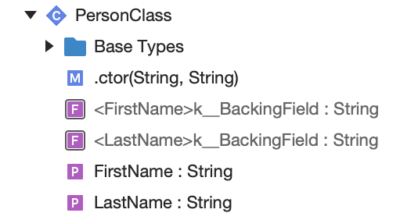
Record Type
Record Type
Class
Compare

Slide 34
Agenda
Hello World
Record Type
Enumerable
Async / Await
MoveNext()

Slide 35
Enumerable
using System;
using System.Collections.Generic;
using System.Linq;
foreach(var n in Fibonacci().Take(10))
{
Console.Write($"{n}, ");
}
Console.WriteLine($"{Fibonacci().ElementAt(10)}");
C#

Slide 36
Enumerable
static IEnumerable<int> Fibonacci()
{
yield return 0;
int value = 1;
int next = 1;
while (true)
{
yield return value;
int t = value;
value = next;
next += t;
}
}
output
0, 1, 1, 2, 3, 5, 8, 13, 21, 34, 55
C#

Slide 37
Enumerable
Original
Compiled
using System;
using System.Collections.Generic;
using System.Linq;
foreach(var n in Fibonacci().Take(10))
{
Console.Write($"{n}, ");
}
Console.WriteLine($"{Fibonacci().ElementAt(10)}");
static IEnumerable<int> Fibonacci()
{
yield return 0;
int value = 1;
int next = 1;
while (true)
{
yield return value;
int t = value;
value = next;
next += t;
}
}
using System;
using System.Collections.Generic;
using System.Linq;
private static void _003CMain_003E_0024 (string[] args)
{
foreach (int item in Fibonacci ().Take (10)) {
Console.Write ($"{item}, ");
}
Console.WriteLine ($"{Fibonacci ().ElementAt (10)}");
static IEnumerable<int> Fibonacci ()
{
yield return 0;
int value = 1;
int next = 1;
while (true) {
yield return value;
int num = value;
value = next;
next += num;
}
}
}
C#

Slide 38
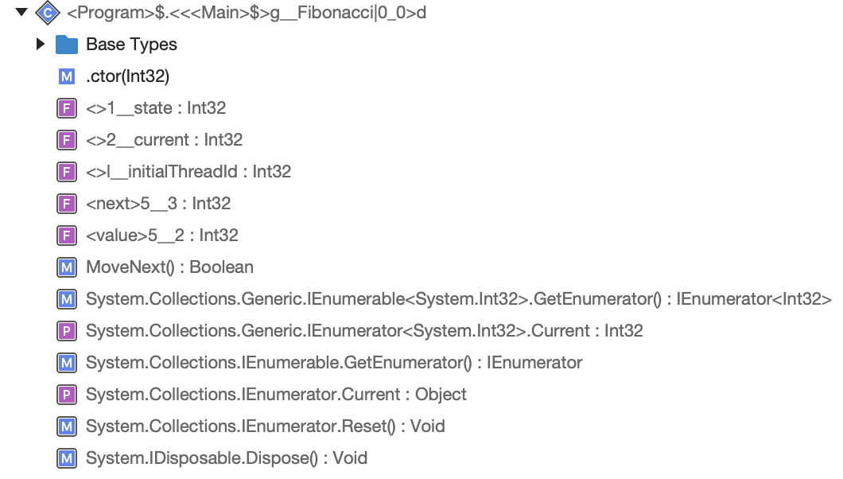
Enumerable
Compiled

Slide 39
Enumerable
Builder
Processor
uses
creates
runs
State Machine
user code

Slide 40
Enumerable
GetEnumerator
MoveNext
Enumerable
uses
creates
runs
_state
user code

Slide 41
Enumerable
the State Machine is the Context

Slide 42
Enumerable
start state
Compiled
var sequence = new EnumerableFibonacci(-2);
foreach (var n in sequence.Take(10))
{
Console.Write($"{n}, ");
}
Console.WriteLine($"{sequence.ElementAt(10)}");
simplified
C#

Slide 43
Enumerable
Enumerable
hidden class
Compiled
public class EnumerableFibonacci : IEnumerable<int>, IEnumerable, IEnumerator<int>, IEnumerator, IDisposable
{
private int _state;
private int _current;
private int _initialThreadId;
private int value;
private int next;
enumerable variables
local variables
simplified
C#

Slide 44
Enumerable
Enumerable
Compiled
public EnumerableFibonacci(int state)
{
this._state = state;
_initialThreadId = Environment.CurrentManagedThreadId;
}
simplified
C#

Slide 45
Enumerable
Get Enumerator
Compiled
IEnumerator<int> IEnumerable<int>.GetEnumerator()
{
if (_state == -2 && _initialThreadId == Environment.CurrentManagedThreadId)
{
_state = 0;
return this;
}
return new EnumerableFibonacci(0);
}
simplified
C#

Slide 46
Enumerable
Compiled
int IEnumerator<int>.Current
{
get
{
return _current;
}
}
simplified
C#

Slide 47
Enumerable
MoveNext
Compiled
private bool MoveNext()
{
const int ERROR = -1;
switch (_state)
{
default:
return false;
case 0:
// initial
_state = ERROR;
_current = 0; // Fibonacci(0)
_state = 1;
return true;
case 1:
// 1st
_state = ERROR;
value = 1; // Fibonacci(1)
next = 1; // Fibonacci(2)
break;
case 2:
// rest
_state = ERROR;
int temp = value;
value = next;
next += temp;
break;
}
_current = value;
_state = 2;
return true;
}
rest
state
first
initial
simplified
C#

Slide 48
Enumerable
MoveNext
Compiled
private bool MoveNext()
{
const int ERROR = -1;
switch (_state)
{
default:
return false;
case 0:
// initial
_state = ERROR;
_current = 0; // Fibonacci(0)
_state = 1;
return true;
case 1:
// 1st
_state = ERROR;
value = 1; // Fibonacci(1)
next = 1; // Fibonacci(2)
break;
case 2:
// rest
_state = ERROR;
int temp = value;
value = next;
next += temp;
break;
}
_current = value;
_state = 2;
return true;
}
Original
rest
yield return 0;
0
state
first
initial
simplified
C#

Slide 49
Enumerable
MoveNext
Compiled
private bool MoveNext()
{
const int ERROR = -1;
switch (_state)
{
default:
return false;
case 0:
// initial
_state = ERROR;
_current = 0; // Fibonacci(0)
_state = 1;
return true;
case 1:
// 1st
_state = ERROR;
value = 1; // Fibonacci(1)
next = 1; // Fibonacci(2)
break;
case 2:
// rest
_state = ERROR;
int temp = value;
value = next;
next += temp;
break;
}
_current = value;
_state = 2;
return true;
}
rest
Original
int value = 1;
int next = 1;
state
first
initial
1
simplified
C#

Slide 50
Enumerable
MoveNext
Compiled
2
private bool MoveNext()
{
const int ERROR = -1;
switch (_state)
{
default:
return false;
case 0:
// initial
_state = ERROR;
_current = 0; // Fibonacci(0)
_state = 1;
return true;
case 1:
// 1st
_state = ERROR;
value = 1; // Fibonacci(1)
next = 1; // Fibonacci(2)
break;
case 2:
// rest
_state = ERROR;
int temp = value;
value = next;
next += temp;
break;
}
_current = value;
_state = 2;
return true;
}
Original
rest
yield return value;
int t = value;
value = next;
next += t;
state
first
initial
simplified
C#

Slide 51
Enumerable
Main
foreach
Enumerable
GetEnumerator
MoveNext
Current
_state

Slide 52
Enumerable
Main
foreach
start
Enumerable
GetEnumerator
MoveNext
Current
-2

Slide 53
Enumerable
Main
foreach
initial
Enumerable
GetEnumerator
MoveNext
Current
0

Slide 54
Enumerable
Main
foreach
2nd
first
1st
Enumerable
GetEnumerator
true
0
1

Slide 55
Enumerable
Main
foreach
2nd
rest
1st
Enumerable
GetEnumerator
true
1
2

Slide 56
Enumerable
skip to the end…

Slide 57
Enumerable
Main
foreach
2nd
rest
1st
Enumerable
GetEnumerator
true
34
2

Slide 58
Enumerable
Original
foreach( var n in Fibonacci().Take(10))
{
Console.Write($"{n}, ");
}
C#

Slide 59
Agenda
Hello World
Record Type
Enumerable
Async / Await
MoveNext()

Slide 60
Async / Await
using System;
using System.Threading.Tasks;
var x = Identity(6);
var y = await IdentityAsync(7);
Console.WriteLine($"{x:X4} + {y:X4} = {x * y:X4}");
static T Identity<T>(T x) => x;
static async Task<T> IdentityAsync<T>(T x) => x;
output
0006 + 0007 = 002A
only difference is async
C#

Slide 61
Async / Await
Original
Compiled
using System;
using System.Threading.Tasks;
var x = Identity(6);
var y = await IdentityAsync(7);
Console.WriteLine($"{x:X4} + {y:X4} = {x * y:X4}");
static T Identity<T>(T x) => x;
static async Task<T> IdentityAsync<T>(T x) => x;
using System;
using System.Runtime.CompilerServices;
using System.Threading.Tasks;
[CompilerGenerated]
internal static class _003CProgram_003E_0024
{
private static async Task _003CMain_003E_0024 (string[] args)
{
int x2 = Identity<int> (6);
int num = await IdentityAsync<int> (7);
Console.WriteLine ($"{x2:X4} + {num:X4} = {x2 * num:X4}");
static T Identity<T> (T x)
{
return x;
}
[AsyncStateMachine (typeof(_003C_003C_003CMain_003E_0024_003Eg__IdentityAsync_007C0_1_003Ed<>))]
static Task<T> IdentityAsync<T> (T x)
{
_003C_003C_003CMain_003E_0024_003Eg__IdentityAsync_007C0_1_003Ed<T> stateMachine = default(_003C_003C_003CMain_003E_0024_003Eg__IdentityAsync_007C0_1_003Ed<T>);
stateMachine._003C_003Et__builder = AsyncTaskMethodBuilder<T>.Create ();
stateMachine.x = x;
stateMachine._003C_003E1__state = -1;
stateMachine._003C_003Et__builder.Start (ref stateMachine);
return stateMachine._003C_003Et__builder.Task;
}
}
}
C#

Slide 62
Async / Await
Wrapper
Helper
Processor
creates
starts
creates
uses
references
runs
State Machine
user code

Slide 63
Async / Await
the State Machine is the Context

Slide 64
Async / Await
Wrapper
Compiled
hidden class
[AsyncStateMachine(typeof(IdentityAsync<>))]
static Task<T> IdentityAsyncWraper<T>(T x)
{
IdentityAsync<T> stateMachine = default(IdentityAsync<T>);
stateMachine._builder = AsyncTaskMethodBuilder<T>.Create();
stateMachine.x = x;
stateMachine._state = -1;
stateMachine._builder.Start(ref stateMachine);
return stateMachine._builder.Task;
}
create State Machine
set Async Helper
set Parameters
set Initial State
call Async MoveNext
return Async Task
simplified
C#

Slide 65
Async / Await
Processor
Compiled
[StructLayout(LayoutKind.Auto)]
struct IdentityAsync<T> : IAsyncStateMachine
{
public int _state;
public AsyncTaskMethodBuilder<T> _builder;
public T x;
private void SetStateMachine(IAsyncStateMachine stateMachine)
{
_builder.SetStateMachine(stateMachine);
}
void IAsyncStateMachine.SetStateMachine(IAsyncStateMachine stateMachine)
{
this.SetStateMachine(stateMachine);
}
}
place State Machine on Heap
parameter
simplified
C#

Slide 66
Async / Await
MoveNext
Compiled
private void MoveNext()
{
T result;
try
{
result = x;
}
catch (Exception exception)
{
_state = -2;
_builder.SetException(exception);
return;
}
_state = -2;
_builder.SetResult(result);
}
-2 state = complete
simplified
C#

Slide 67
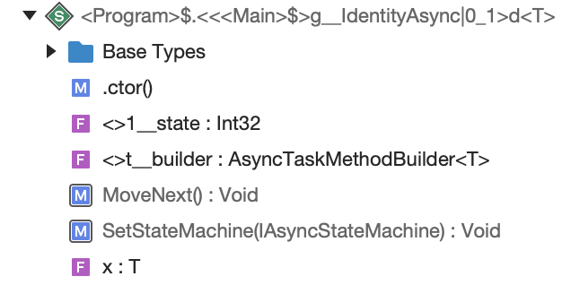
Async / Await
Original
Compiled
static async Task<T> IdentityAsync<T>(T x) => x;
C#

Slide 68
Async / Await
Main
await
1st
AsyncWrapper
Create
Start
MoveNext
Async
2nd

Slide 69
Async / Await
something more interesting…

Slide 70
Async / Await
using System;
using System.Threading.Tasks;
await PrintAndWait(TimeSpan.FromMilliseconds(10));
static async Task PrintAndWait(TimeSpan delay)
{
Console.WriteLine("before delays");
await Task.Delay(delay);
Console.WriteLine("between delays");
await Task.Delay(delay);
Console.WriteLine("after delays");
}
output
before delays
between delays
after delays
C#

Slide 71
Async / Await
Original
using System;
using System.Threading.Tasks;
await PrintAndWait(TimeSpan.FromMilliseconds(10));
static async Task PrintAndWait(TimeSpan delay)
{
Console.WriteLine("before delays");
await Task.Delay(delay);
Console.WriteLine("between delays");
await Task.Delay(delay);
Console.WriteLine("after delays");
}
Compiled
using System;
using System.Runtime.CompilerServices;
using System.Threading.Tasks;
[CompilerGenerated]
internal static class _003CProgram_003E_0024
{
private static async Task _003CMain_003E_0024 (string[] args)
{
await PrintAndWait (TimeSpan.FromMilliseconds (10.0));
[AsyncStateMachine (typeof(_003C_003C_003CMain_003E_0024_003Eg__PrintAndWait_007C0_0_003Ed))]
static Task PrintAndWait (TimeSpan delay)
{
_003C_003C_003CMain_003E_0024_003Eg__PrintAndWait_007C0_0_003Ed stateMachine4 = default(_003C_003C_003CMain_003E_0024_003Eg__PrintAndWait_007C0_0_003Ed);
stateMachine4._003C_003Et__builder = AsyncTaskMethodBuilder.Create ();
stateMachine4.delay = delay;
stateMachine4._003C_003E1__state = -1;
stateMachine4._003C_003Et__builder.Start (ref stateMachine4);
return stateMachine4._003C_003Et__builder.Task;
}
}
}
C#

Slide 72
Async / Await
Processor
Compiled
hidden class
[StructLayout(LayoutKind.Auto)]
struct PrintAndWaitAsync : IAsyncStateMachine
{
public int _state;
public AsyncTaskMethodBuilder _builder;
public TimeSpan delay;
private TaskAwaiter _awaiter;
private void SetStateMachine(IAsyncStateMachine stateMachine)
{
_builder.SetStateMachine(stateMachine);
}
void IAsyncStateMachine.SetStateMachine(IAsyncStateMachine stateMachine)
{
this.SetStateMachine(stateMachine);
}
place State Machine on Heap
parameter
simplified
C#

Slide 73
Async / Await
MoveNext
Compiled
private void MoveNext()
{
int num = _state;
try
{
TaskAwaiter awaiter;
if (num != 0)
{
if (num == 1)
{
awaiter = _awaiter;
_awaiter = default(TaskAwaiter);
num = (_state = -1);
goto done;
}
Console.WriteLine("before delays");
awaiter = Task.Delay(delay).GetAwaiter();
if (!awaiter.IsCompleted)
{
num = (_state = 0);
_awaiter = awaiter;
_builder.AwaitUnsafeOnCompleted(ref awaiter, ref this);
return;
}
}
else
{
awaiter = _awaiter;
_awaiter = default(TaskAwaiter);
num = (_state = -1);
}
awaiter.GetResult();
Console.WriteLine("between delays");
awaiter = Task.Delay(delay).GetAwaiter();
if (!awaiter.IsCompleted)
{
num = (_state = 1);
_awaiter = awaiter;
_builder.AwaitUnsafeOnCompleted(ref awaiter, ref this);
return;
}
goto done;
done:
awaiter.GetResult();
Console.WriteLine("after delays");
}
catch (Exception exception)
{
_state = -2;
_builder.SetException(exception);
return;
}
_state = -2;
_builder.SetResult();
}
simplified
C#

Slide 74
Async / Await
MoveNext
Original
Console.WriteLine("before delays");
await Task.Delay(delay);
Compiled
Console.WriteLine("before delays");
awaiter = Task.Delay(delay).GetAwaiter();
if (!awaiter.IsCompleted)
{
num = (_state = 0);
_awaiter = awaiter;
_builder.AwaitUnsafeOnCompleted(ref awaiter, ref this);
return;
}
creates thread with awaiter
simplified
C#

Slide 75
Async / Await
Main
AwaitUnsafeOnCompleted
rest …
2nd
1st
thread
wait …
MoveNext
ready

Slide 76
Async / Await
MoveNext
Original
Console.WriteLine("between delays");
await Task.Delay(delay);
Compiled
awaiter.GetResult();
Console.WriteLine("between delays");
awaiter = Task.Delay(delay).GetAwaiter();
if (!awaiter.IsCompleted)
{
num = (_state = 1);
_awaiter = awaiter;
_builder.AwaitUnsafeOnCompleted(ref awaiter, ref this);
return;
}
goto done;
creates thread with awaiter
done with async
simplified
C#

Slide 77
Async / Await
Main
AwaitUnsafeOnCompleted
goto done
2nd
1st
thread
wait …
MoveNext
ready

Slide 78
Async / Await
MoveNext
Original
Console.WriteLine("after delays");
Compiled
done:
awaiter.GetResult();
Console.WriteLine("after delays");
state = -2;
_builder.SetResult();
result of Task
simplified
C#

Slide 79
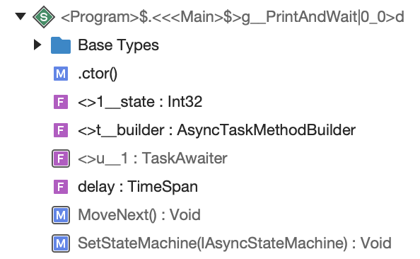
Async / Await
Original
using System;
using System.Threading.Tasks;
await PrintAndWait(TimeSpan.FromMilliseconds(10));
static async Task PrintAndWait(TimeSpan delay)
{
Console.WriteLine("before delays");
await Task.Delay(delay);
Console.WriteLine("between delays");
await Task.Delay(delay);
Console.WriteLine("after delays");
}
Compiled

Slide 80
Agenda
Hello World
Record Type
Enumerable
Async / Await
MoveNext()

Slide 81
Next Steps
C# in Depth, Fourth Edition by Jon Skeet chapter 6
Working with C# Records by Roland Guijt on Pluralsight https://app.pluralsight.com/library/courses/working-c-sharp-records/table-of-contents
SharpLab build by Andrey Shchekin https://sharplab.io/
check out other programming languages
racket https://racket-lang.org/
rust https://www.rust-lang.org/
pony https://www.ponylang.io/

Slide 82

Thank you
https://github.com/MikeMKH/talk-my-compiler-did-what
Mike Harris My Compiler Did What?!? @MikeMKH https://github.com/MikeMKH/talk-my-compiler-did-what

